Slide 1
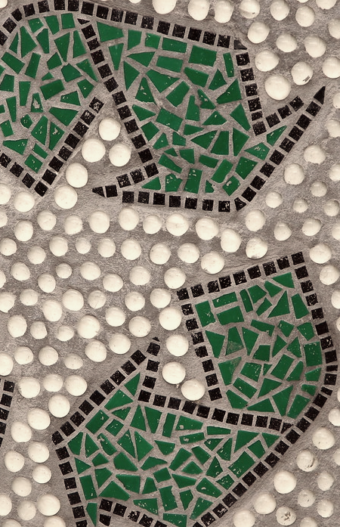
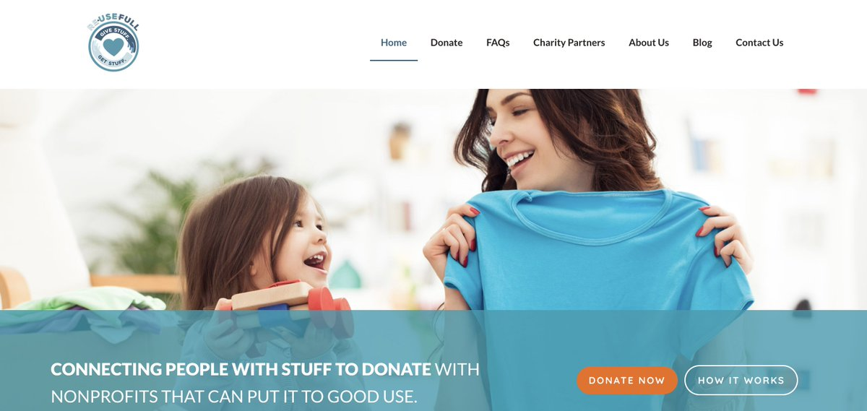
My Work With Re.Use.Full
Bryan Richlinski
bdrxbc@umsystem.edu.
Introduction: For my community service project I volunteered for reusefull.org a startup charity working under the umbrella of Code for KC. reusefull.org is a website that helps people planning to donate any lightly used items to a local charity that will take them.
Contribution: I started volunteering about 11 weeks ago and have volunteered 1-2 hours of my time each week. I would estimate the total time I have spent is approximately 13-15 hours. I would contribute by attending weekly zoom meetings and giving what creative input I could regarding the website. My main position, though, was to create social media content for the organization, mostly on twitter. I would ensure that they had a minimum of 1 post every day covering topics of recycling, updates about the charity, and upcycling ideas for reusing old items.
Ethical Implications: The purpose of this organization aligns very well with principle 1.1 of the code to “promote environmental sustainability”, as the entire purpose of the organization is to prevent waste by facilitating reuse[1]. As I was creating content it became obvious that I would need to use more photos and visuals for my posts, this made me conscious of section 1.5 of the code: “Computing professionals should therefore credit the creators of ideas, inventions, (and) work” [1]. I avoided any conflict with the code by using images from creative commons and commenting the source provided. There was one incident that caused me to become more acutely aware of section 1.3 of the code: “Be honest and Trustworthy” [1]. After promoting a pledge created by the non-profit “Keep America Beautiful”, by coincidence I discovered that they were in fact a well disguised corporate greenwashing front. I was left with the choice of moving on and hoping nobody would notice or crafting an apology and letting people know the mistake I had made. I immediately crafted an apology, informed my superior of my findings, and allowed them to make the final decision whether to tweet the apology or not.
Conclusion: While creating twitter content for reusefull.com I found that even seemingly mundane tasks can have ethical implications. Having read the ACM code for this class allowed me to keep ethics and its importance in mind during this volunteer project. I believe that regularly reviewing the code should become a routine for any professional, no matter how indirectly they are associated with computing.
References:
[1] ACM Code of Ethics & Professional Conduct. Association for Computing Machinery. https://ethics.acm.org, viewed 12/13/2020.
[2] Homepage. Re.Use.Full. https://reusefull.org/, viewed 12/13/2020.
[3] "Reduce Reuse Recycle" by Steve Snodgrass. Creative Commons. https://search.creativecommons.org/photos/9450542e-dcd4-44ff-985c-1f7b76bc1145, viewed 12/13/2020.

